Slide 1
MEDICARE FOR RADIOLOGISTS: What is New for 2020-2021
Via Webinar
April 16, 2020
6:00-7:00 PM

Slide 2
WE WILL DISCUSS
Healthcare is Rapidly Changing-2020 & Beyond
Brief Look at COVID-19
Many audits and TPE slowed or stopped
Increase in telehealth codes / sites
Emergency wavers for most states
Financial support possible
Some Things Don’t Change This Year
Clear Documentation Still Important
Electronic Med Records/Problematic
TPE (Targeted Probe and Educate)
What Noridian is Now Reviewing
Looking at Changes
National and Local Coverage Decisions
Patient Facing Coding for MIPS/MACRA
Documentation Simplification
Appropriate Utilization Criteria / Imaging
Evaluation and Management Changes
A Brief Look At the Future of Healthcare for Physicians and their professional staff
Q&A

Slide 3
NORIDIAN HOT LINE
To support our providers, a COVID-19 Hotline has been established to help with COVID-19 related inquiries. The hotline number is: 866-575-4067. Customer services reps will be available Monday-Friday from 8 a.m.-6 p.m. CDT. The hotline will answer questions on provisional billing privileges and enrollment flexibilities afforded by the COVID-19 waiver for health care facilities and providers, as well as on Part A, B, and DME accelerated/ advance payments related to COVID-19
CMS ON LINE EMERGENCY PAGE: https://www.cms.gov/About-CMS/Agency-Information/Emergency/EPRO/Current-Emergencies/Current-Emergencies-page

Slide 4
CARES Act Provider Relief Fund
On March 27, 2020, the President signed the bipartisan CARES Act that provides $100 billion in relief funds to hospitals and other healthcare providers on the front lines of the coronavirus response. This funding will be used to support healthcare-related expenses or lost revenue attributable to COVID-19 and to ensure uninsured Americans can get testing and treatment for COVID-19.
Recognizing the importance of delivering funds in a fast and transparent manner, $30 billion is being distributed immediately – with payments arriving via direct deposit beginning April 10, 2020 – to eligible providers throughout the American healthcare system.
These are payments, not loans, to healthcare providers, and will not need to be repaid.
Is this different than CMS Accelerated / Advance Payment Program?
Yes. The CMS Accelerated and Advance Payment Program has delivered billions of dollars to healthcare providers to help ensure providers and suppliers have the resources needed to combat the pandemic. The CMS accelerated and advance payments are a loan that providers must pay back. Read more information from CMS.
All relief payments are being made to providers and according to their tax identification number (TIN).
https://www.hhs.gov/provider-relief/index.html

Slide 5
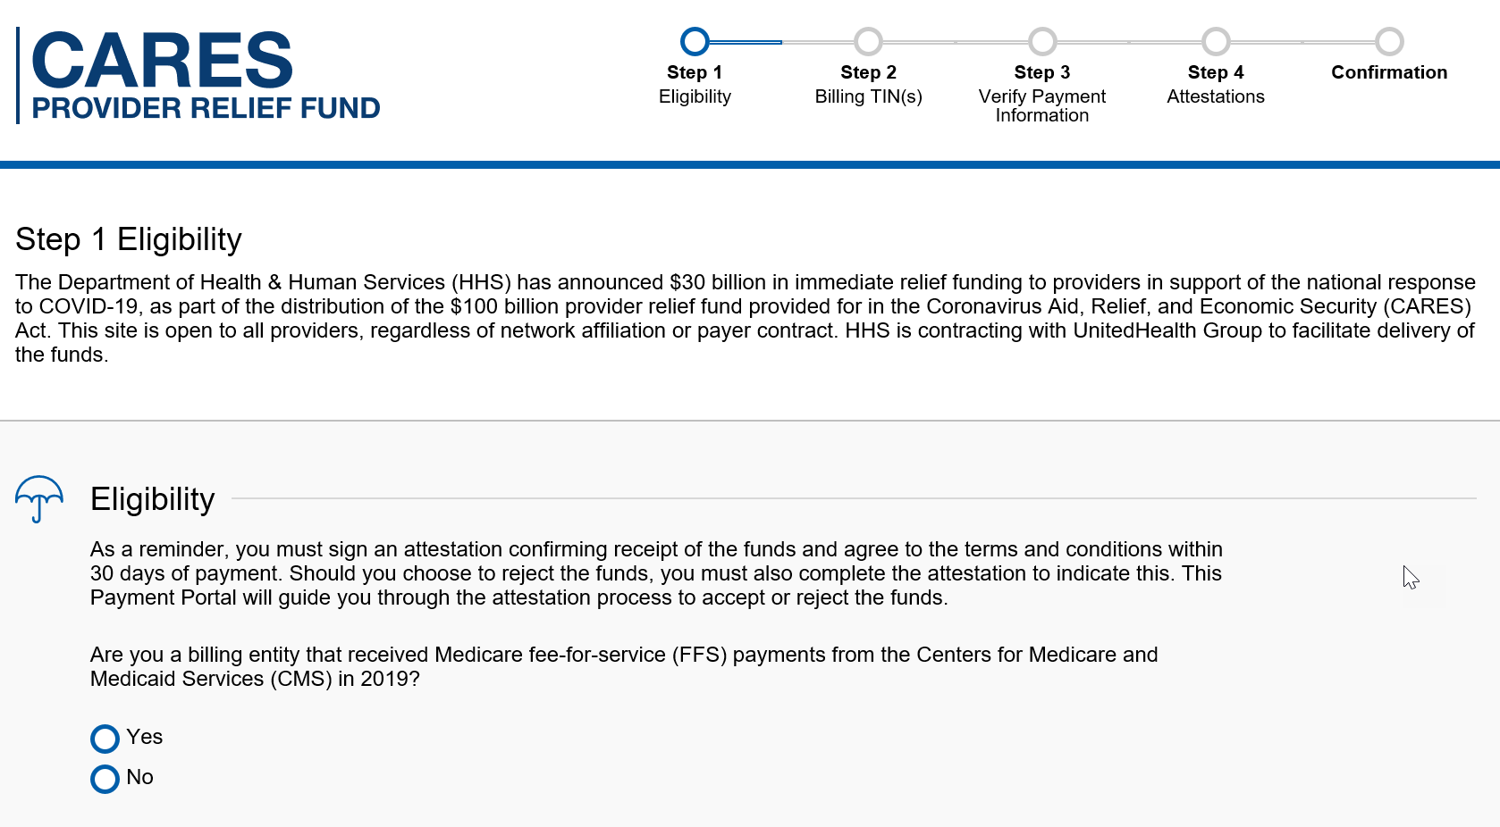
https://covid19.linkhealth.com/#/step/1

Slide 6
Accelerated/Advance Payment Program for Medicare Providers
Funds have been provided through expansion of the Accelerated and Advance Payment Program to ensure providers and suppliers have the resources needed to combat the pandemic.
The streamlined process implemented by CMS for COVID-19 has reduced processing times for a request of an accelerated or advance payment to between four to six days
Payments are available to Part A providers, including hospitals, and Part B suppliers, including doctors, non-physician practitioners and durable medical equipment (DME) suppliers. While most of these providers and suppliers can receive three months of their Medicare reimbursements, certain providers can receive up to six months

Slide 7
Accelerated/Advance Payment Program for Medicare Providers
Advance and accelerated payments are a loan providers must pay back.
CMS will begin to apply claims payments to offset the accelerated/advance payments 120 days after disbursement.
Part B suppliers will have up to 210 days to complete repayment of accelerated and advance payments, respectively. Interest rates occur if not repaid
The fact sheet on the accelerated/advance payment process and how to submit a request can be found here: Fact Sheet.
Providers can also contact their Medicare Administrative Contractor for any questions.
https://www.cms.gov/files/document/Accelerated-and-Advanced-Payments-Fact-Sheet.pdf

Slide 8
ELIGIBILITY
To qualify for advance/accelerated payments the provider/supplier must:
1. Have billed Medicare for claims within 180 days immediately prior to the date of signature on the provider’s/supplier’s request form,
2. Not be in bankruptcy,
3. Not be under active medical review or program integrity investigation, and
4. Not have any outstanding delinquent Medicare overpayments.
Amount of Payment: Qualified providers/suppliers will be asked to request a specific amount using an Accelerated or Advance Payment Request form provided on each MAC’s website. Most providers and suppliers will be able to request up to 100% of the Medicare payment amount for a three-month period.

Slide 9
RECOUPMENT & RECONCILLATION
The provider can continue to submit claims as usual after the issuance of accelerated or advance payment;
Recoupment will not begin for 120 days. Providers will receive full payments for their claims during the 120-day delay period.
At the end of the 120-day period, the recoupment process will begin and every claim submitted by provider will be offset from the new claims to repay accelerated advanced payment. Thus, instead of receiving payment for newly submitted claims, the provider’s outstanding accelerated/advance payment balance is reduced by the claim payment amount. This process is automatic.

Slide 10
REQUESTING ADVANCED PAYMENT
Complete Request Form
Noridian Healthcare Solutions - Jurisdiction E & F
Toll-free Hotline: 1-866-575-4067 Hours of Operation: 8:00 am – 6:00 pm CT
Provider/supplier identification information:
i. Legal Business Name/ Legal Name;
ii. Correspondence Address;
iii. National Provider Identifier (NPI);
iv. Other information as required by the MAC
Amount requested based on your need:
Most providers and suppliers will be able to request up to 100% of the Medicarepayment amount for a three-month period
Reason for request:
Please check box 2
State request is for an accelerated/advance payment due to COVID-19 pandemic
Signed by an authorized representative of the provider.
Submit form: electronically, or FAX, e-mail, regular mail or contact Noridian
See Fact Sheet

Slide 11
Quality Payment Program and Quality Reporting Program/Value Based Purchasing Program COVID-19 Relief
On March 22, 2020, CMS announced relief for clinicians, providers, hospitals and facilities participating in quality reporting programs in response to the 2019 Novel Coronavirus (COVID-19). This memorandum and factsheet supplements and provides additional guidance to health care providers with regard to the announcement.
CMS has extended the 2019 Merit-based Incentive Payment System (MIPS) data submission deadline from March 31 by 30 days to April 30, 2020. This and other efforts are to provide relief to clinicians responding to the COVID-19 pandemic.
In addition, the MIPS automatic extreme and uncontrollable circumstances policy will apply to MIPS eligible clinicians who do not submit their MIPS data by April 30, 2020 deadline.
You can find a copy of the memo here: Memo
You can find a copy of the fact sheet here: Fact Sheet

Slide 12
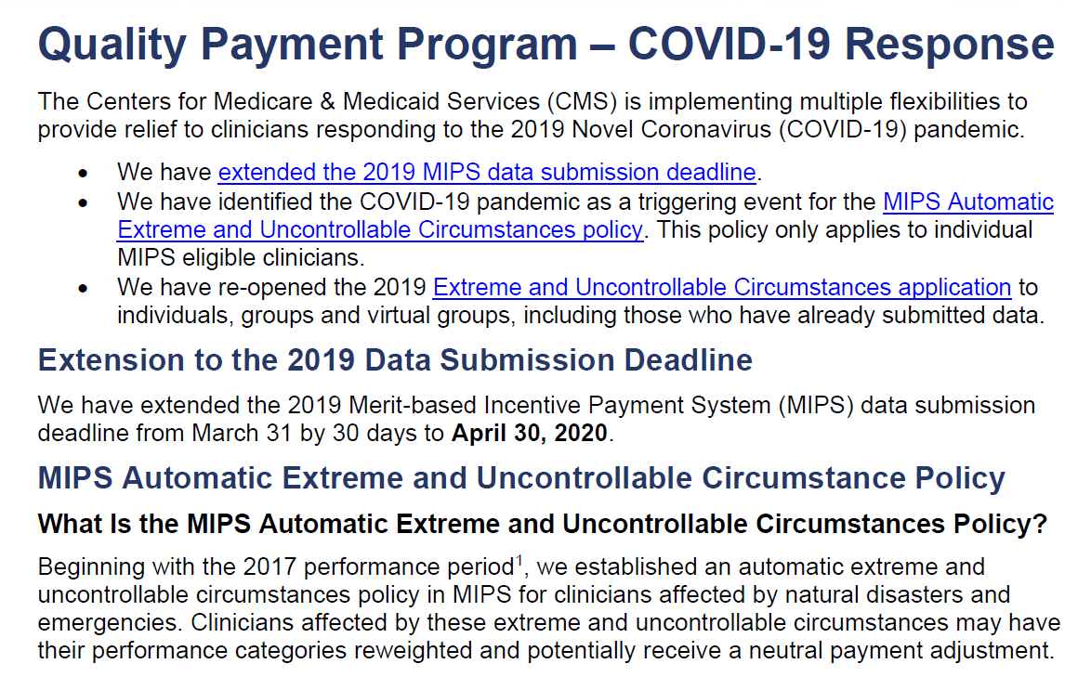
https://qpp-cm-prod-content.s3.amazonaws.com/uploads/966/QPP%20COVID-19%20Response%20Fact%20Sheet.pdf

Slide 13
DOCUMENTING REASONABLE & NECESSARY:
Only the actual physician who is treating the patient knows what is reasonable and necessary for that patient being evaluated and treated.
The only way a Noridian reviewer can determine if something is (was) reasonable and necessary on a claim is to review the complete documentation submitted

Slide 14
LOOKING AT EMR CLAIMS
EMR Must be up to date for each visit—not cloned
Reasonable and Necessary still rules in 2019 for each visit and each service
Review of systems: must be coherent & Decision Making Most Important
Helpful if explained / listed / or documented in chart
Important to list changes in care or diagnoses since last visit
Lab review helps decision making
Excess verbiage on some EHR still does not give extra value, nor unnecessary E&M points. Services must be reasonable and necessary
EMRs take time to learn---by doctor or scribe, and some doctors are uncomfortable with electronic records and the time it takes to fill them out
Get me outta here

Slide 15
EMR-CLINICAL CHARTS AND RADIOLOGISTS
Unfortunately if a radiology code is being audited for any reason, ordering physician must have a reason for ordering it
Reason can be in the order sent or dictated
Reason can be anywhere in the ordering physician’s chart
Ordering physician’s chart can show reason of unusual imaging by
“Rule outs” in chart
“Concerned about possible” in chart
Part of decision making in chart
If reason not obvious by diagnosis or in the ordering physician chart notes, claim will be denied

Slide 16
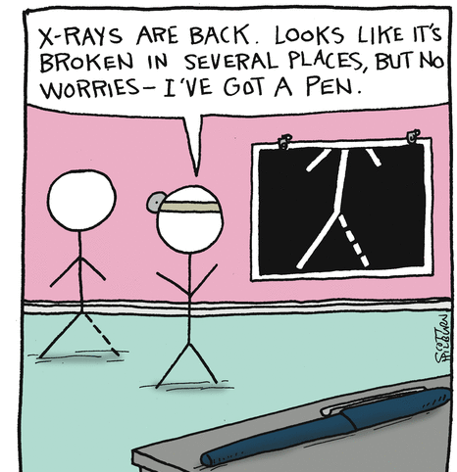

Slide 17
TARGETED PROBE AND EDUCATION
CURRENT MEDICAL REVIEW PROCESS!!
CMS authorized Medicare Contractors to conduct the Targeted Probe and Educate (TPE) Pilot review process. The TPE review process includes three rounds of a prepayment probe review with education.
If there are continued high denials after three rounds, the Medicare Contractor will refer the provider/supplier to CMS for additional action, which may include 100% prepay review, extrapolation, referral to a Recovery Auditor, etc.
Note, discontinuation of review may occur at any time if appropriate improvement is achieved during the review process.
PROGRAM HELD DURING COVID-19 EMERGENCY

Slide 18
Your facility was selected for review based on data analysis. A trending graph is provided below comparing your facility’s six month billing data to previous six month billing data for XXXXX It indicates an increased utilization of this code as compared to your previous utilization data.
TPE LETTER
Reason of Review (for Part B Claims):
“You have been identified as having an error rate of greater than or equal to XX% during a Service Specific Target Review for CPT XXXXX” OR “You are in the top XX% for this code. A prepayment review has been initiated to probe a sample of your claims billed with the following CPT codes: XXXXX will be reviewed”

Slide 19
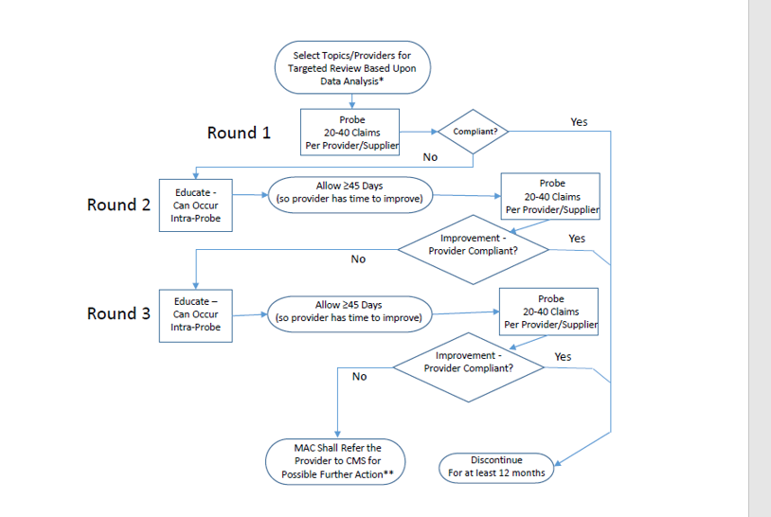
TARGETED PROBE
AND EDUCATION

Slide 20
SOME RECENT CLINICAL REVIEWS (AUDITS) INVOLVING RADIOLOGY AND RADIATION THERAPY
IMRT, SBRT and Complex Radiology / Radiotherapy
Chest X-ray codes (71020-71046)
CTA, chest (noncoronary with contrast) 71275
Therapeutic radiology simulation-aided field setting (77280) and Radiation Treatment Delivery (77386)
77412 - Radiation treatment delivery, >1 MeV
70540 - CT of head and brain
72197 - MRI pelvis w/wo contrast
77063 - Screening digital breast tomosynthesis, bilateral
74177 - CT Abdomen and pelvis with contrast
78452 – Myocardial SPECT scan

Slide 21
NATIONAL / LOCAL COVERAGE DETERMINATIONS ARE CHANGING
Created by CMS or under CMS control
Usually have open/transparent process
Presented at MEDCAC open meetings at CMS that anyone can attend and comment
Written notice and comment always allowed
Must be followed by administrative law judges
In future, MACs may initiate codes and edits---to speed up NCD effectuation and use
CMS will ultimately review and confirm
Reconsiderations always possible
Process subject to change as science changes

Slide 22
NCD’S AFFECTING RADIOLOGY
Bone (Mineral) Density Studies
Computed Tomography
Digital Subtraction Angiography
FDG PET for Dementia and Neurodegenerative Diseases
FDG PET for Infection and Inflammation
FDG PET for Myocardial Viability
FDG PET for Refractory Seizures
Lung Cancer Screening with Low Dose Computed Tomography (LDCT)
Magnetic Resonance Angiography
Magnetic Resonance Imaging
Magnetic Resonance Spectroscopy
Mammograms
PET for Perfusion of the Heart
Positron Emission Tomography (FDG) for Oncologic Conditions
Positron Emission Tomography (NaF-18) to Identify Bone Metastasis of Cancer
Positron Emission Tomography (PET) Scans
Ultrasound Diagnostic Procedures
https://www.cms.gov/medicare-coverage-database/indexes/ncd-alphabetical-index.aspx?bc=AQAAAAAAAAAA&

Slide 23
LOCAL COVERAGE DETERMINATIONS
Local Coverage Determination (LCD) More Transparent
Rationale must be given for any new coverage changes
Literature explained in policy---increased number journals
Sent to CMS 21 days prior to publication---medical input accepted
Contractor Advisory Committee: will be changing
Initial CAC is evidentiary with Subject Matter Experts reviewing
Contractors take information from SME and write draft policy
Draft policy explained at Open Meeting—open to all for comment
CAC / Open meetings can be live meetings and / or webinars
Guidelines. white papers & journals from societies important
National or Local Coverage Determinations explained in detail on Noridian website and CMS website—we tell you how to code
Changes will still be possible for LCDs
Individual Considerations for patients with specific situations
Reconsiderations of local policy possible with submission of appropriate peer reviewed literature or society white papers
We value your opinions, but when asking for changes, SHOW US THE DATA…in God we trust, everyone else needs data

Slide 24
NORIDIAN LCDs AFFECTING RADIOLOGY
Chest X-Ray Policy
Intensity Modulated Radiation Therapy (IMRT)
Lumbar MRI
Magnetic-Resonance-Guided Focused Ultrasound Surgery (MRgFUS) for Essential Tremor
MRI and CT Scans of the Head and Neck
Percutaneous Vertebral Augmentation (PVA) for Osteoporotic Vertebral Compression Fracture (VCF)
Stereotactic Body Radiation Therapy
Stereotactic Radiosurgery
https://med.noridianmedicare.com/web/jeb/policies/lcd/active

Slide 25
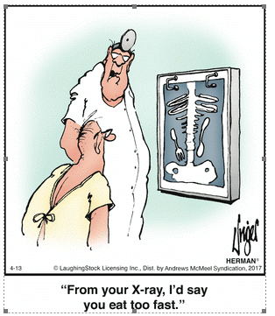

Slide 26
PATIENT RELATIONSHIP CATEGORIES FOR MACRA / MIPS
CMS will be considering the utility of patient relationship categories and codes to improve the attribution of resources to clinicians in developing measures of cost, as required by the Medicare Access and CHIP Reauthorization Act (MACRA) Pub. L. No. 114-10
Section 101(f) of MACRA requires that we post the operational list of patient relationship categories and codes by April 2017 and that the codes be included by clinicians on all Medicare claims, as determined appropriate by the Secretary, beginning ………… (soon)

Slide 27
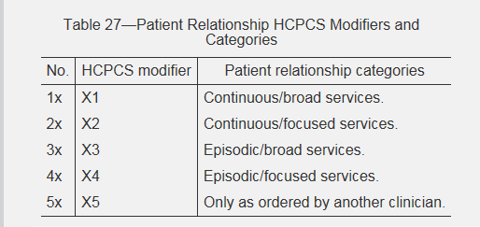
FEDERAL REGISTER 11/15/2017 Page 53233

Slide 28
CMS Patient Relationship Categories and Codes
1. Continuous/broad: This category could include clinicians who provide principal care for a patient, where there is no planned endpoint of the relationship. Care in this category is comprehensive, dealing with the entire scope of patient problems, either directly or in a care coordination role. (X1)
Examples include: Primary care, specialists providing comprehensive care to patients in addition to specialty care, etc.
2. Continuous/focused: This category could include a specialist whose expertise is needed for the ongoing management of a chronic disease or a condition that needs to be managed and followed for a long time. (X2)
Examples include: A rheumatologist taking care of a patient’s rheumatoid arthritis longitudinally but not providing general primary care services.
3. Episodic/broad: This category could include clinicians that have broad responsibility for the comprehensive needs of the patients, but only during a defined period and circumstance, such as a hospitalization. (X3)
Examples include: A hospitalist providing comprehensive and general care to a patient while admitted to the hospital.

Slide 29
CMS Patient Relationship Categories and Codes
4. Episodic/focused: This category could include a specialist focused on particular types of time-limited treatment. The patient has a problem, acute or chronic, that will be treated with surgery, radiation, or some other type of generally time-limited intervention. (X4)
Examples include, but are not limited to: An orthopedic surgeon performing a knee replacement and seeing the patient through the postoperative period.
5. Only as ordered by another clinician: This category could include a clinician who furnishes care to the patient only as ordered by another clinician. This relationship may not be adequately captured by the alternative categories suggested above and may need to be a separate option for clinicians who are only providing care ordered by other clinicians. (X5)
Examples include, but are not limited to: A radiologist interpreting an imaging study ordered by another clinician.
Reporting of these modifiers will be mandatory in the near future. Uncertain when they will be required

Slide 30
EVALUATION AND MANAGEMENT: 2020 AND BEYOND
For CY 2020, CMS will continue the current coding and payment structure for E/M office/outpatient visits and physicians should continue to use either the 1995 or 1997 E/M guidelines to document E/M office and/or outpatient visits billed to Medicare.
For CY 2020, CMS has implemented several policies to provide immediate burden reduction, while other changes to documentation, coding, and payment would be implemented in CY 2021.
For E/M office/outpatient visits, for both new and established patients, practitioners need not re-enter in the medical record information on patient’s chief complaint and history that has already been entered by ancillary staff, physicians in training or beneficiary.
Indicate in medical record that the physician reviewed and verified this information; and sign & date record or chart.

Slide 31
PAYMENT SYSTEM FOR E&M CODES WILL BE LESS COMPLICATED
But very problematic for many!!!

Slide 32
SUMMARY OF AMA REVISIONS: 2021
Effective January 2021-office E&M
Eliminate history and physical as elements for code section:
While the physician’s work in capturing the patient’s pertinent history and performing a relevant physical exam contributes to both the time and medical decision making, these elements alone should not determine the appropriate code level.
The Workgroup revised the code descriptors to state providers should perform a “medically appropriate history and/or examination”

Slide 33
SUMMARY OF REVISIONS 2021
Allow physicians to choose whether their documentation is based on Medical Decision Making (MDM) or Total Time:
MDM: The Workgroup did not materially change the three current MDM sub-components, but did provide extensive edits to the elements for code selection and revised/created numerous clarifying definitions in the E/M guidelines. (See below for additional discussion.)
Time: The definition of time is minimum time, not typical time, and represents total physician/qualified health care professional (QHP) time on the date of service. The use of date-of-service time builds on the movement over the last several years by Medicare to better recognize the work involved in non-face-to-face services like care coordination. These definitions only apply when code selection is primarily based on time and not MDM.

Slide 34
SUMMARY OF REVISIONS
Deletion of CPT code 99201: The Panel agreed to eliminate 99201 as 99201 and 99202 are both straightforward MDM & only different by history and exam elements.
Creation of a shorter Prolonged Services code:
The Panel created a shorter prolonged services code that would capture physician/QHP time in 15-minute increments.
This code would only be reported with 99205 and 99215 and be used when time was the primary basis for code selection.
CMS has accepted the revisions proposed by AMA

Slide 35
AND MORE IN 2021….FROM CMS
Implementation of add-on codes that describe additional resources inherent in visits for primary care and particular kinds of non-procedural specialized medical care, (though they would not be restricted by physician specialty).
These codes would only be reportable with E/M office/outpatient level 5 visits, and
Their use generally would not impose new per-visit documentation requirements; and
Adoption of a new “extended visit” add-on code for use only with E/M office/outpatient level 5 visits to account for the additional resources required when practitioners need to spend extended time with the patient.

Slide 36
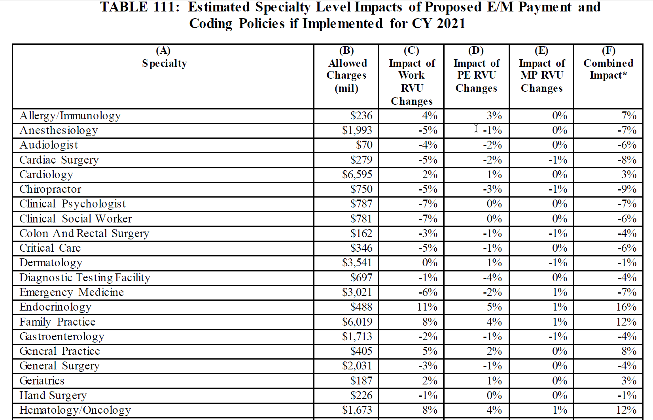
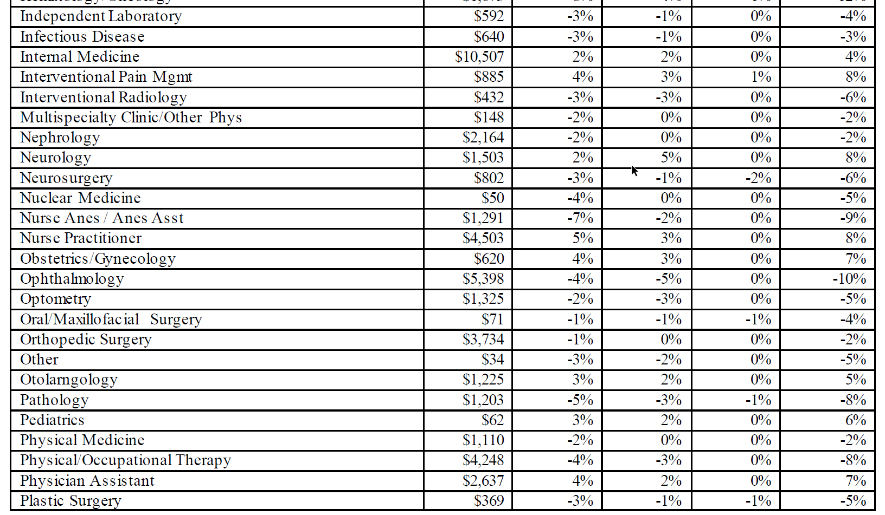
HOW CHANGES WOULD AFFECT MEDICARE PAYMENT

Slide 38
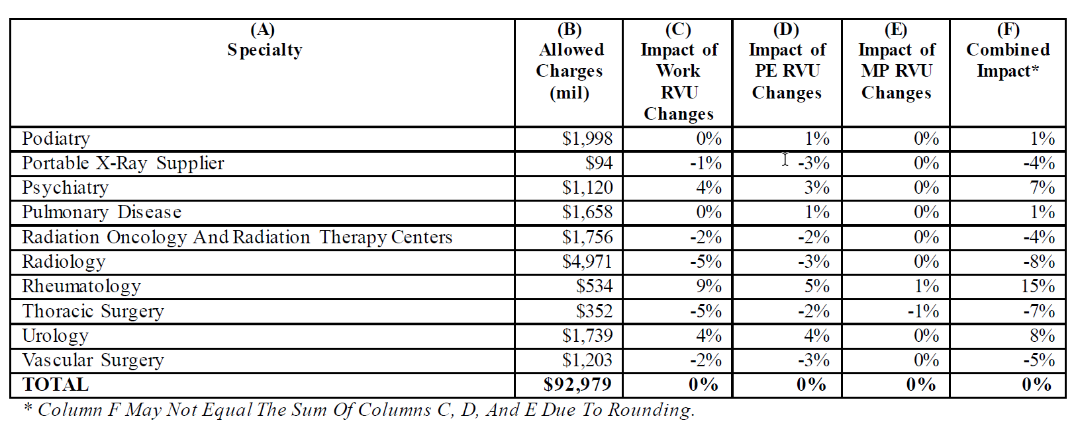
https://s3.amazonaws.com/public-inspection.federalregister.gov/2019-16041.pdf Page 1187, Table 111

Slide 39
LIMITED MEDICARE PREAUTHORIZATION STARTS JULY 1, 2020, BUT MAY BE DELAYED
“Its easier to pull a rabbit from a hat than to get authorization for your procedure”

Slide 40
APPROPRIATE USE CRITERIA: AUC
The Protecting Access to Medicare Act (PAMA) of 2014, Section 218(b), established a new program to increase the rate of appropriate advanced diagnostic imaging services provided to Medicare beneficiaries. Examples of such advanced imaging services include:
Computed tomography (CT)
Positron emission tomography (PET)
Nuclear medicine, and
Magnetic resonance imaging (MRI)
When a practitioner orders an advanced diagnostic imaging service for a Medicare beneficiary, he/she, or clinical staff acting under his/her direction, will be required to consult a qualified Clinical Decision Support Mechanism (CDSM).
CDSMs are electronic portals through which appropriate use criteria (AUC) is accessed
CDSM provides a determination of whether the order adheres to AUC, or if the AUC consulted was not applicable
A consultation must take place at the time of the order for imaging services furnished in one of the settings and paid for under one of the below payment systems. Ultimately, practitioners whose ordering patterns are considered outliers will be subject to prior authorization.

Slide 41
PRIORITY CLINICAL AREAS
AUC consultation is required for all advanced diagnostic imaging services, not just those within the priority clinical areas
Current Priority Clinical Areas
Coronary artery disease (suspected or diagnosed)
Suspected pulmonary embolism
Headache (traumatic and non-traumatic)
Hip pain
Low back pain
Shoulder pain (to include suspected rotator cuff injury)
Lung cancer(primary / metastatic, suspected or diagnosed)
Cervical or neck pain
When program is implemented, a consultation must take place for any applicable imaging service ordered by an ordering professional that would be furnished in an applicable setting and paid under an applicable payment system, e.g., office, hospital outpatient departments (including ED, ambulatory surgical centers (ASCs), and IDTFs… for payment in PFS, OPPS, ASCs

Slide 42
2020: VOLUNTARY PARTICIPATION
Voluntary participation from July 1, 2018 through January 1, 2020.
During CY 2020 we expect ordering professionals to begin consulting qualified CDSMs and providing information to the furnishing practitioners and providers for reporting on their claims.
Situations in which furnishing practitioners and providers do not receive AUC-related information from the ordering professional can be reported by modifier MH.
Even though claims will not be denied during this Educational and Operations Testing Period inclusion is encouraged as it is important for CMS to track this information.
Full program implementation is expected Jan. 1, 2021. At that time, information regarding the ordering professional’s consultation with CDSM, or exception to such consultation, must be appended to the furnishing professional’s claim in order for that claim to be paid
HCPCS modifiers have been established for this program for placement on the same line as CPT code

Slide 43
EXCEPTIONS AND CONSEQUENCES
Exceptions to consulting CDSMs include:
Ordering professional has significant hardship exception
Patient has an emergency medical condition
An applicable imaging service ordered for an inpatient and for which payment made under Part A
PAMA requires that the program result in prior authorization for ordering professionals that are identified as having outlier ordering patterns. Before the prior authorization component of this program begins there will be notice and comment rulemaking to develop the outlier methodology
HCPCS modifiers have been established for this program for placement on the same line as CPT code
Additionally a G code is needed to report which qualified CDSM was consulted.

Slide 44
HCPCS MODIFIERS TO USE
MA: Ordering professional not required to consult a clinical decision support mechanism due to service rendered to a patient with a suspected or confirmed emergency medical condition
MB: Ordering professional is not required to consult a clinical decision support mechanism due to the significant hardship exception of insufficient internet access
MC: Ordering professional is not required to consult a clinical decision support mechanism due to the significant hardship exception of electronic health record or clinical decision support mechanism vendor issues
MD: Ordering professional is not required to consult a clinical decision support mechanism due to the significant hardship exception of extreme and uncontrollable circumstances

Slide 45
HCPCS MODIFIERS TO USE
ME: The order for this service adheres to the appropriate use criteria in the clinical decision support mechanism consulted by the ordering professional
MF: The order for this service does not adhere to the appropriate use criteria in the qualified clinical decision support mechanism consulted by the ordering professional
MG: The order for this service does not have appropriate use criteria in the clinical decision support mechanism consulted by the ordering professional
MH: Unknown if ordering professional consulted a clinical decision support mechanism for this service, related information was not provided to the furnishing professional or provider
And you have to select a specific clinical decision support company…

Slide 46
ADDITIONAL G CODES NEEDED
G1000: Clinical Decision Support Mechanism Applied Pathways, as defined by the Medicare Appropriate Use Criteria Program
G1001: Clinical Decision Support Mechanism eviCore, as defined by the Medicare Appropriate Use Criteria Program
G1002: Clinical Decision Support Mechanism MedCurrent, as defined by the Medicare Appropriate Use Criteria Program
G1003: Clinical Decision Support Mechanism Medicalis, as defined by the Medicare Appropriate Use Criteria Program
G1004: Clinical Decision Support Mechanism National Decision Support Company, as defined by the Medicare Appropriate Use Criteria Program
G1005: Clinical Decision Support Mechanism National Imaging Associates, as defined by the Medicare Appropriate Use Criteria Program
G1006: Clinical Decision Support Mechanism Test Appropriate, as defined by the Medicare Appropriate Use Criteria Program

Slide 47
ADDITIONAL G CODES NEEDED
G1007: Clinical Decision Support Mechanism AIM Specialty Health, as defined by the Medicare Appropriate Use Criteria Program
G1008: Clinical Decision Support Mechanism Cranberry Peak, as defined by the Medicare Appropriate Use Criteria Program
G1009: Clinical Decision Support Mechanism Sage Health Management Solutions, as defined by the Medicare Appropriate Use Criteria Program
G1010: Clinical Decision Support Mechanism Stanson, as defined by the Medicare Appropriate Use Criteria Program
G1011: Clinical Decision Support Mechanism, qualified tool not otherwise specified, as defined by the Medicare Appropriate Use Criteria Program
G1012: Clinical Decision Support Mechanism Agilemd as defined by the Medicare Appropriate Use Criteria Program

Slide 48
ADDITIONAL G CODES NEEDED
G1013: Clinical Decision Support Mechanism Evidence Care Imaging Advisor, as defined by the Medicare Appropriate Use Criteria Program
G1014: Clinical Decision Support Mechanism Inveniga Semantic Answers in Medicine, as defined by the Medicare Appropriate Use Criteria Program
G1015: Clinical Decision Support Mechanism Reliant Medical Group, as defined by the Medicare Appropriate Use Criteria Program
G1016: Clinical Decision Support Mechanism Speed of Care, as defined by the Medicare Appropriate Use Criteria Program
G1017: Clinical Decision Support Mechanism, Healthhelp, as defined by the Medicare Appropriate Use Criteria Program
G1018: Clinical Decision Support Mechanism Infinx as defined by the Medicare Appropriate Use Criteria
G1019: Clinical Decision Support Mechanism Logicnets as defined by the Medicare Appropriate Use Criteria

Slide 49
SOME FUTURE THOUGHT
Newer radio pharmaceuticals for cancer therapy and diagnoses arriving in the market
New less invasive surgical techniques developing
Artificial intelligence assisting diagnoses via mathematic algorithms or literature searches
Changes in medical school programs and teaching methods across the country
More virtual and telemedicine visits everywhere
More gadgets for self monitoring by patients
Sub, sub, subspecialties emerging
Increase in NPPs and various medical jobs: scribes, assistants, therapists, coders, etc.
Non physicians running / owning practices
But before banging your head, everything is still subject to change by law or custom

Slide 50
CAT GOT YOUR TONGUE?
Ask all your questions---maybe I can answer some

Slide 51
A FINAL THOUGHT : COMMUNICATION IN MEDICINE
Healthcare changing from individual to team sport:
Doctors in shared single / multispecialty groups
Internists and surgeons
Emergency room doctors and intensivists
Primary care doctors and hospitalists
Specialists and sub-specialists
Consultants and different consultants
Doctors and patients
“Providers” and “reviewers”
Communication becomes key to patient care, success and patient safety, hindered by EMRs
Written and verbal, legible and understandable
Here is one of the most famous examples of lack of communication…

